Slide 1

AI-Powered Crop Disease Detection and Farmer Advisory System
Course Code: CSA1707
Course Name: Artificial Intelligence
Presented By:
Athavan k(192524036)
Santhosh S(192524049)
Yogesh kumar S(192524067)
Under the supervision:
Dr. Veeramani R

Slide 2


Introduction
Agriculture is the primary source of livelihood for millions of farmers worldwide.
Crop diseases significantly reduce agricultural productivity and crop quality.
Traditional disease detection relies on manual inspection, which is time-consuming and requires expert knowledge.
Artificial Intelligence (AI) and Computer Vision enable fast and accurate crop disease identification using leaf images.
The proposed system analyzes crop images, detects diseases, and identifies the severity of infection.
2

Slide 3
LITERATURE SURVEY
Author(s) & Year | Title | Methodology | Key Findings | Limitations
Mohan (2025) | Using Deep Learning for Image-Based Plant Disease Detection | CNN with PlantVillage dataset | Achieved over 99% accuracy in disease classification under controlled conditions | Performance decreases on real-world field images
Alexander (2024) | Deep Learning Models for Plant Disease Detection | CNN architectures (AlexNet, VGG, GoogLeNet) | High accuracy across multiple crop species and diseases | Requires large labeled datasets and high computational resources
Too & xhan chii(2023) | Comparative Study of Deep Learning Models for Plant Disease Recognition | ResNet, DenseNet, MobileNet, Inception | DenseNet and ResNet provided superior classification accuracy | Increased model complexity and training time
Rajesh (2022) | Deep Learning for Tomato Disease Classification | CNN-based image classification | Accurate detection of tomato leaf diseases | Limited to a single crop and controlled environment

Slide 4
Problem Statement
Crop diseases cause significant reduction in agricultural productivity and farmer income.
Early disease detection is difficult due to the lack of agricultural experts in rural areas.
Manual inspection is time-consuming, costly, and often inaccurate.
Existing disease detection methods require specialized equipment or technical knowledge.
Farmers often struggle to identify the correct disease and choose appropriate treatments.
4

Slide 5
.
Objective
To develop an AI-based system for automatic crop disease detection using leaf images.
To accurately identify different crop diseases using deep learning techniques.
To provide instant treatment recommendations, including suitable pesticides and fertilizers.
To offer preventive measures that help reduce the spread of crop diseases.
To create a user-friendly web/mobile interface that is easy for farmers to use.
3

Slide 6
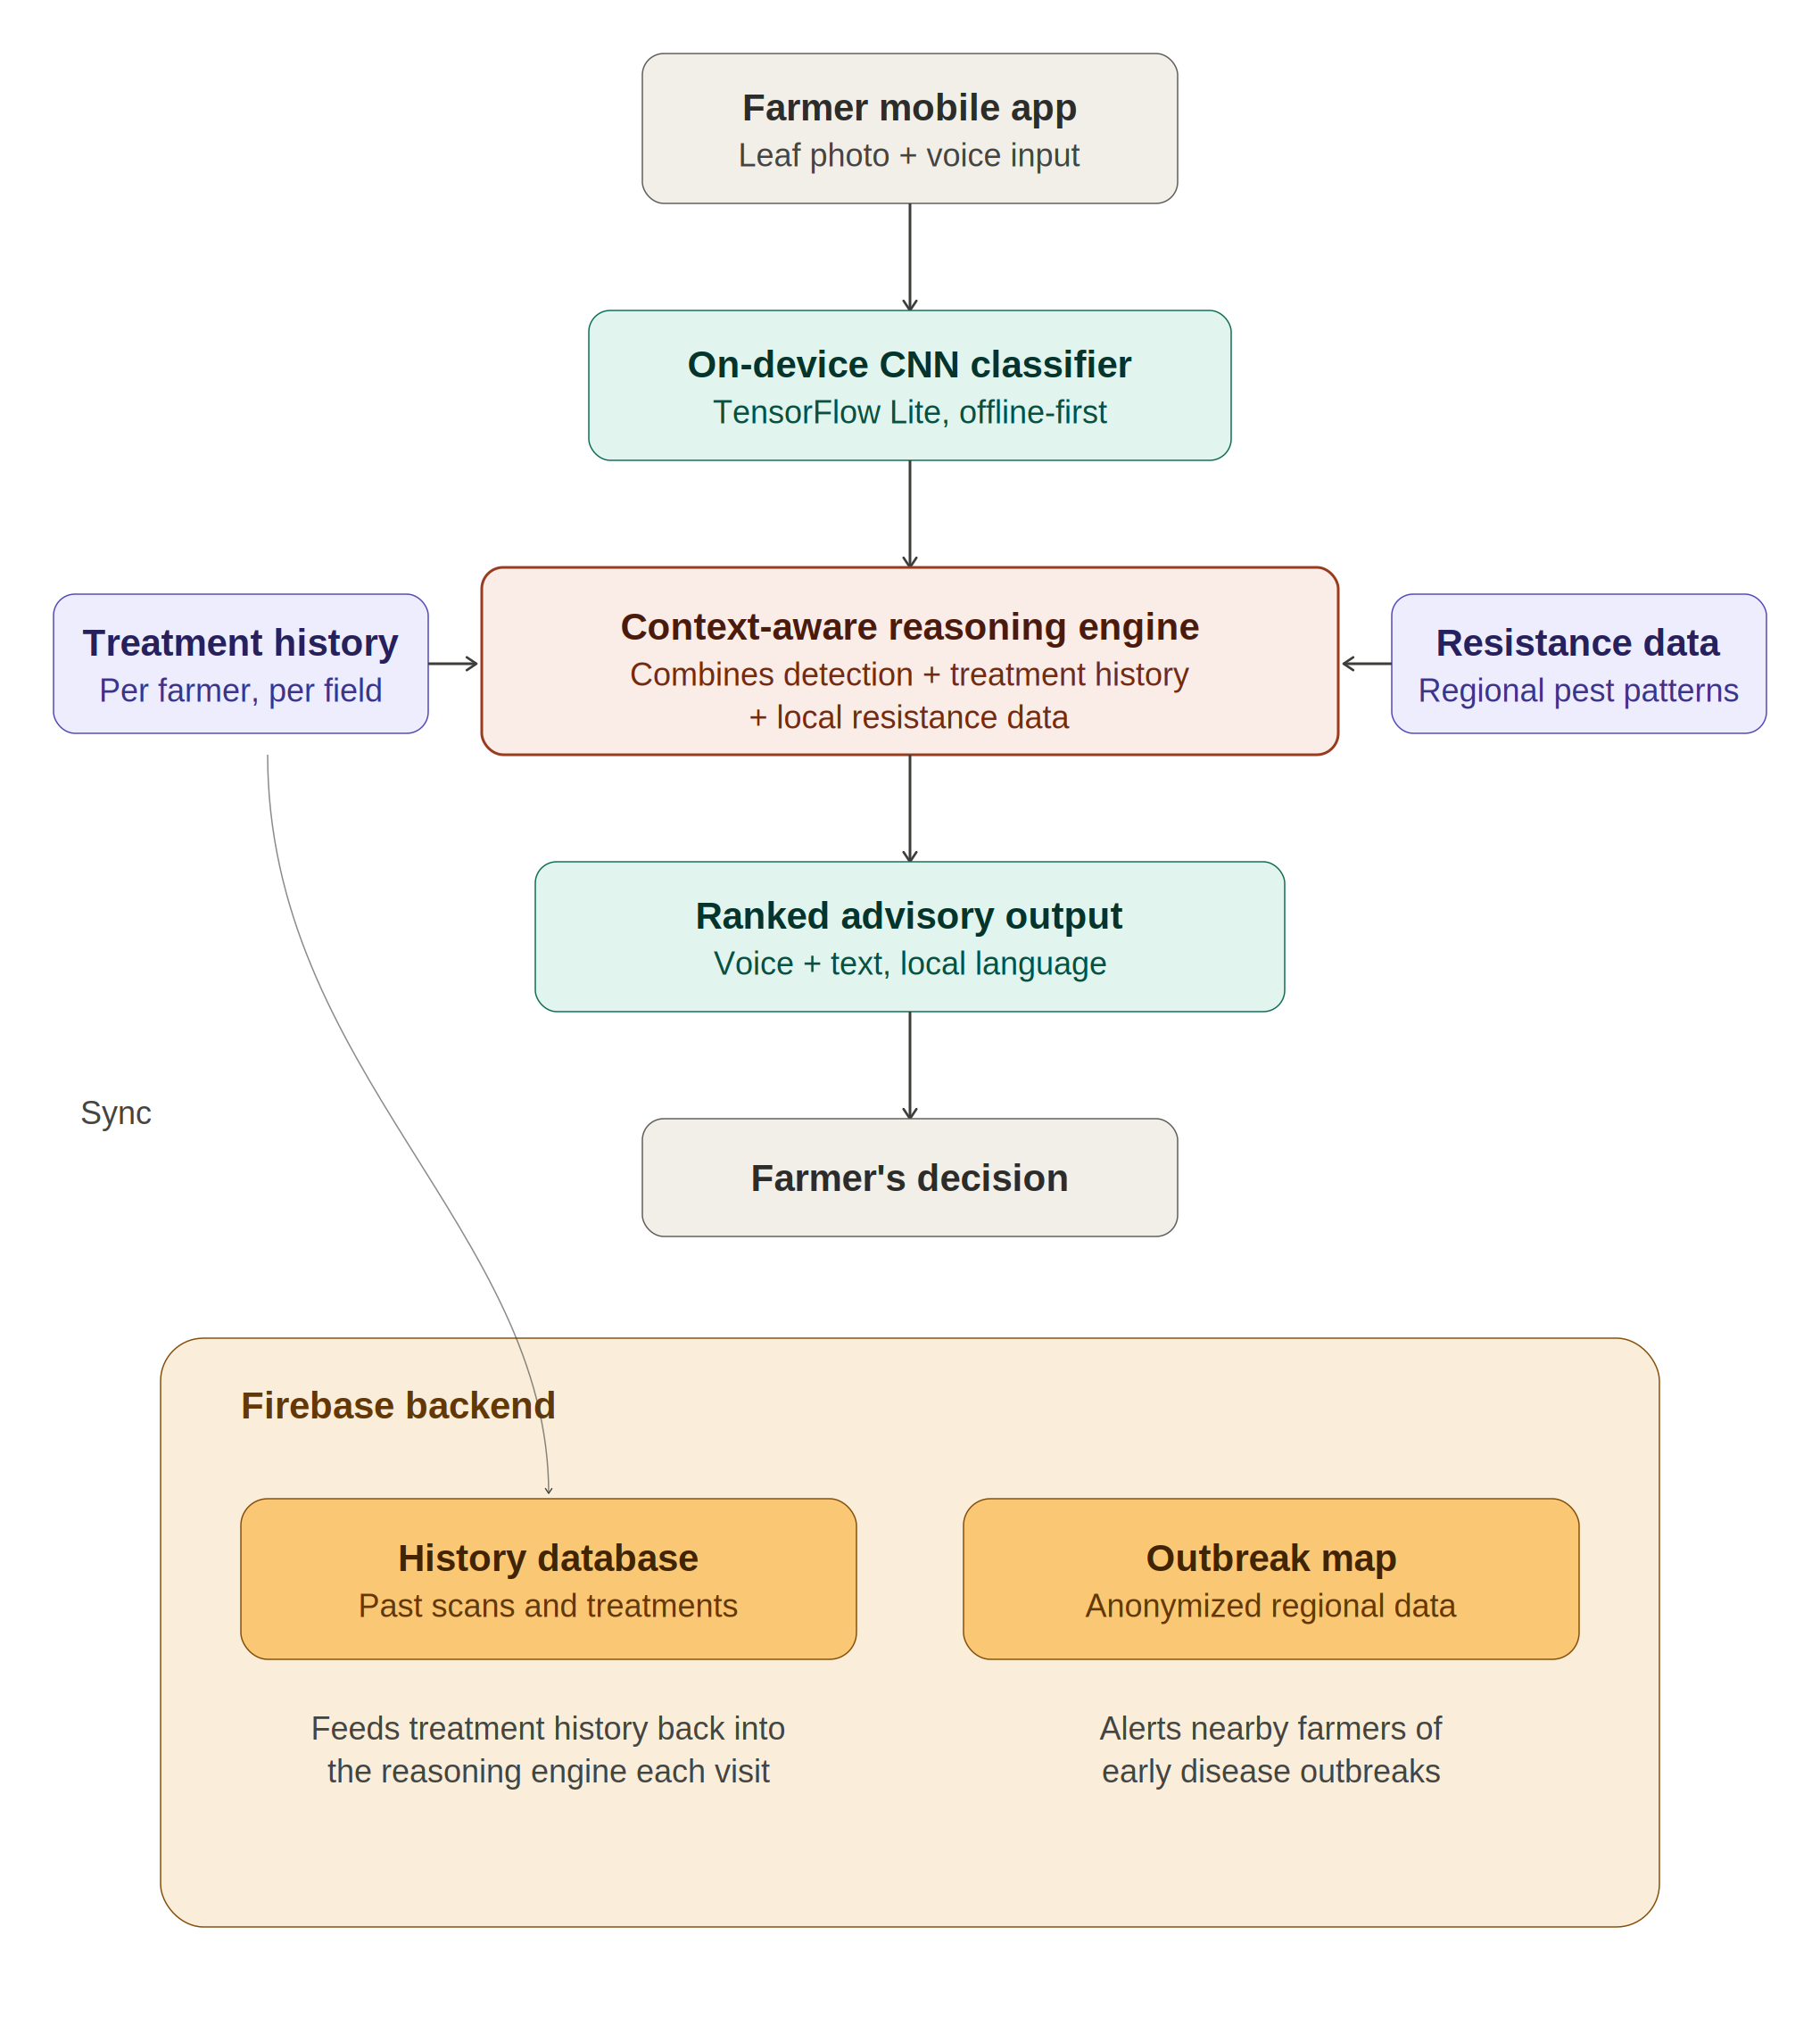
System Architecture

Slide 7
Proposed System
AI-powered mobile application for crop disease detection and farmer advisory
Detects diseases from leaf images using an on-device CNN classifier
Goes beyond static classification by generating a context-aware treatment advisory
Incorporates the farmer's past treatment history to avoid repeat/failed recommendations
Factors in regional pesticide resistance data to avoid ineffective treatments

Slide 8
Module 1: Disease Detection Module
Captures leaf images via the farmer's smartphone camera (single image or batch scan)
Uses a Convolutional Neural Network (CNN), deployed via TensorFlow Lite, to classify the crop disease and estimate severity (mild/moderate/severe)
Runs entirely on-device, enabling functionality without internet access — critical for rural connectivity gaps
Outputs a confidence score; low-confidence results are flagged for expert/community review instead of a forced guess

Slide 9
Module 2: Context-Aware Advisory Reasoning Module
Combines the disease detection output with two additional inputs: the farmer's past treatment history and known local pesticide resistance data
Applies a reasoning/re-ranking layer that avoids recommending treatments the farmer already tried without success
Filters out chemicals with known regional resistance, prioritizing organic remedies before chemical escalation
Generates a ranked, explainable advisory rather than a single static answer

Slide 10
Module 3: Farmer Interface & Community Outbreak Module
Delivers the advisory through a multilingual voice and text interface, designed for low-literacy accessibility
Stores each interaction (scan, diagnosis, treatment chosen) in a Firebase-backed treatment history per farmer/field for future reasoning
Aggregates anonymized, location-tagged detections into a real-time regional outbreak map, alerting nearby farmers and agricultural officers to emerging disease clusters

Slide 11
Conclusion
Moves beyond conventional single-shot disease classification
Treats crop treatment as a sequential, context-aware decision problem
Combines on-device AI detection + treatment history reasoning + community outbreak intelligence
Delivers faster, more relevant, and more sustainable advisory to farmers
Reduces crop loss and minimizes unnecessary pesticide use

Slide 12
Reference
Mohanty, S. P., Hughes, D. P., & Salathé, M. (2016). Using Deep Learning for Image-Based Plant Disease Detection. Frontiers in Plant Science, 7, 1419.
Ferentinos, K. P. (2018). Deep learning models for plant disease detection and diagnosis. Computers and Electronics in Agriculture, 145, 311–318.
Howard, A. G., et al. (2017). MobileNets: Efficient Convolutional Neural Networks for Mobile Vision Applications. arXiv preprint arXiv:1704.04861.
Food and Agriculture Organization (FAO). (2021). The impact of disasters and crises on agriculture and food security.
Google Firebase Documentation. Firebase Realtime Database & Cloud Firestore. https://firebase.google.com/docs

